Slide 1
Data analysis on Airline
By Janvi ambaliya

Slide 2
Introduction
Here I represent one data analysis project with bi tool. I used a airline data set for my presentation. I worked with the many useful tools in power bi which I learned . Here is large data set about 7 continents and many countries. The aim of this project is to showcase my knowledge about data cleaning, data processing and what insights I can find from my skills.

Slide 3
Overview
First of all I read data carefully. After that I watched few columns which are not useful for visualisation after that I removed that column from data set. After I merged some column and changed data types for some column. Then I load data from power query editor with changes. After I thought about measure and I add some measure. I used some aggregate and calculate function for that. Then after I put some card in report view to show the information. And I used matrix for showing report.

Slide 4
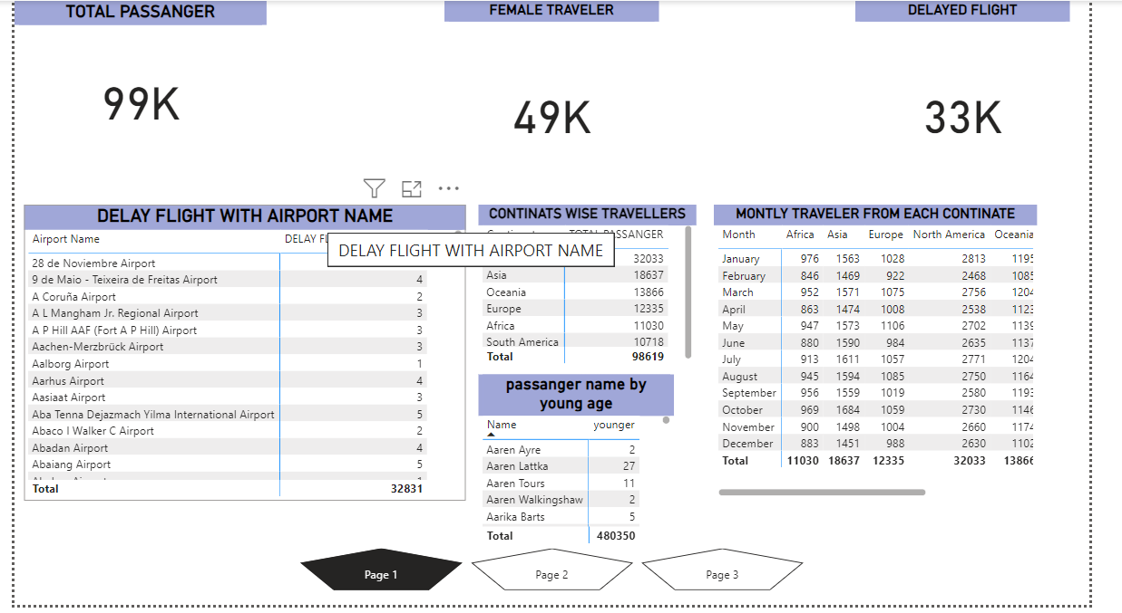

Slide 5
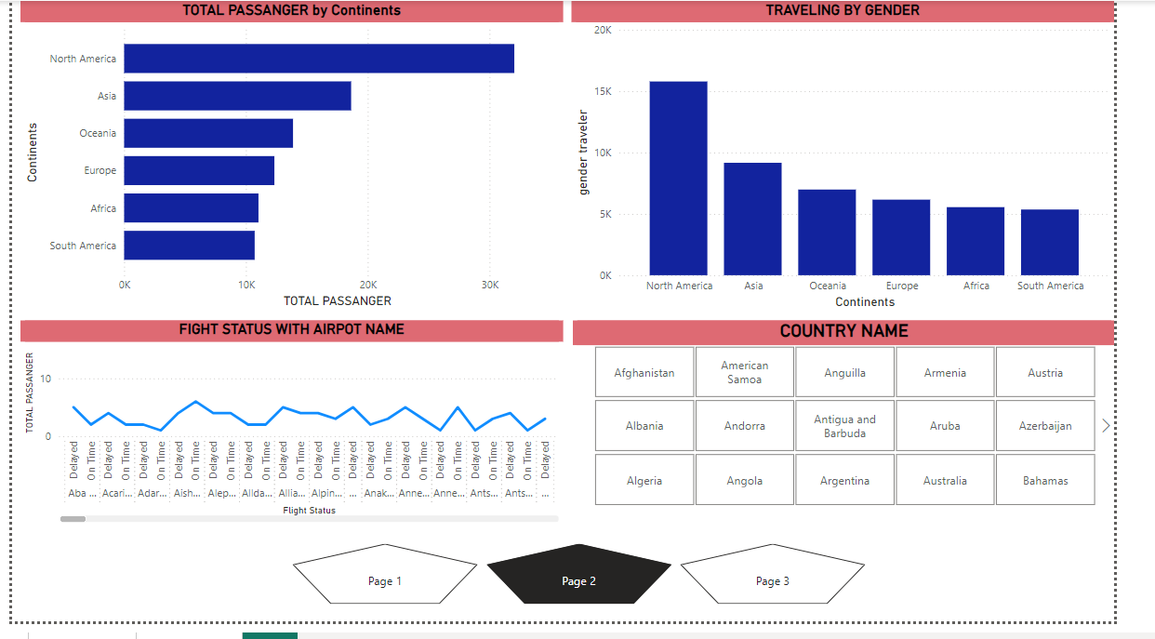

Slide 6
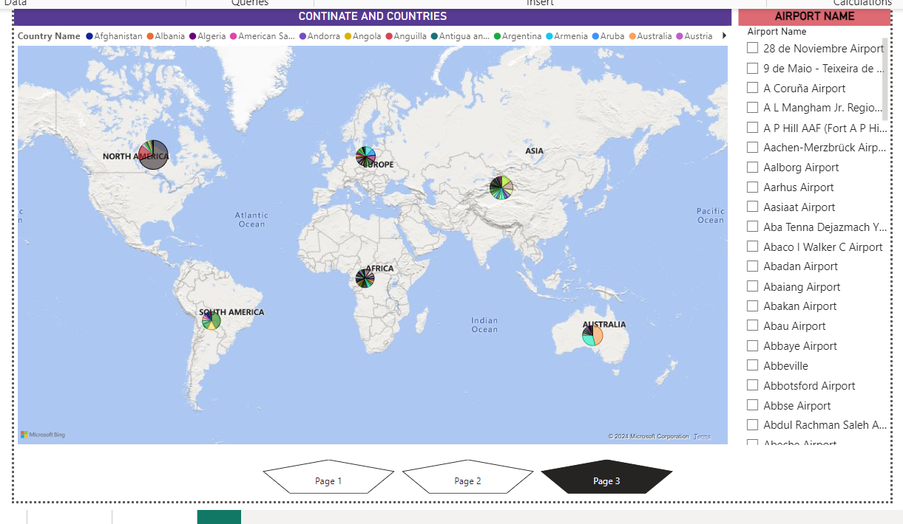

Slide 7
visualisation
From my report view we can say that around 99k passenger are travelling across the world by different different airline. Along with that 49 k passenger are only female travellers and rest of child and male travellers.
After that we can see the airport name where many flight are delayed. Then I divide all passenger with their continents. We can also see there are 48k young travellers from various countries. Also we can get monthly travelling report.

Slide 8
We can see highest travellers from north America and least passenger from south America followed by 32k and 10k.
Also we can get particular country wise information by slicer.
I used map function for getting clear information by airport name.

Slide 9
Conclusion
According to my perspective I used many tools to visualise a data set. But we can also improve the result after day by day using. But this is just an example of my first power bi project. I can do more clear visualisation with experience.

Slide 10
Thank you

